Slide 1

Building a Phonebook Application

Slide 2
Building a Phonebook Application

Slide 3
A Phonebook Application
is a digital system designed
to store, manage, and retrieve contact details efficiently.
It serves as an organized database for personal or
business contacts, typically including names, phone numbers, email addresses,
and other relevant details.
Building a Phonebook Application
Data
Structure for Contacts
Using Linked Lists
for Dynamic Storage
Using Arrays fo
Fixed-Size Storage

Slide 4
Data
Structure for Contacts
Using Linked Lists
for Dynamic Storage
Using Arrays fo
Fixed-Size Storage

Slide 5
Using Linked Lists for Dynamic Storage
Contacts are stored in nodes, each containing details and a pointer to the next contact.
Ideal for dynamic applications where the number of contacts varies.
Allows efficient insertion and deletion without shifting elements.
Suitable for implementing sorting operations like Bubble Sort dynamically
Data
Structure for Contacts
Using Linked Lists
for Dynamic Storage
Using Arrays fo
Fixed-Size Storage

Slide 6
Using Arrays for Fixed-Size Storage
Contacts are stored in an indexed array with a predefined size.
Efficient for small-scale applications with limited contacts.
Allows direct access to a contact using an index.
Limitations: Fixed size, requiring reallocation if more contacts are needed.
Data
Structure for Contacts
Using Linked Lists
for Dynamic Storage
Using Arrays fo
Fixed-Size Storage
Using Linked Lists for Dynamic Storage
Contacts are stored in nodes, each containing details and a pointer to the next contact.
Ideal for dynamic applications where the number of contacts varies.
Allows efficient insertion and deletion without shifting elements.
Suitable for implementing sorting operations like Bubble Sort dynamically

Slide 7


Slide 8

Linear Search checks each contact one by one until the desired name or number is found.
Steps:
Start from the first contact.
Compare with the search query (name/number).
Continue until a match is found or the list ends.
Time Complexity:
Worst case: O(n) (when the contact is last in the list or missing).
Best case: O(1) (when the contact is the first in the list).
Since you're skilled in C programming, implementing these algorithms with arrays or linked lists would be a great way to efficiently manage contacts! Would you like a code snippet or a PowerPoint slide format for this section? Let me know how you'd like it structured!
Linear Search

Slide 9

Bubble Sort is a simple sorting algorithm that repeatedly swaps adjacent elements to arrange them in alphabetical order.
Steps:
Compare adjacent contacts (names).
Swap them if they are in the wrong order.
Repeat until the entire contact list is sorted.
Time Complexity:
Worst case: O(n²) (when contacts are in reverse order).
Best case: O(n) (when contacts are nearly sorted).
Linear Search checks each contact one by one until the desired name or number is found.
Steps:
Start from the first contact.
Compare with the search query (name/number).
Continue until a match is found or the list ends.
Time Complexity:
Worst case: O(n) (when the contact is last in the list or missing).
Best case: O(1) (when the contact is the first in the list).
Since you're skilled in C programming, implementing these algorithms with arrays or linked lists would be a great way to efficiently manage contacts! Would you like a code snippet or a PowerPoint slide format for this section? Let me know how you'd like it structured!
Sorting Contact
Bubble Sort

Slide 10

Edit Contacts
Users enter details like name, phone number, and email.
The data is stored in a structured format (database or file).
Option to categorize contacts (e.g., work, personal).
Search Contacts
Add Contacts
Delete Contacts

Slide 11

Edit Contacts
Modify existing details of a saved contact.
Update phone numbers, addresses, or additional notes.
Ensures data accuracy and relevance.
Search Contacts
Add Contacts
Delete Contacts

Slide 12

Edit Contacts
Locate contacts quickly by name or phone number.
Implements efficient search algorithms for instant retrieval.
Can include filters like "Recently Added" or "Frequently Contacted."
Would you like me to structure this
into a PowerPoint slide format for your presentation? I can also generate
relevant images to visualize these processes!
Search Contacts
Add Contacts
Delete Contacts

Slide 13

Edit Contacts
Remove unwanted or outdated entries.
Maintain a clean and organized contact list.
May include a confirmation prompt to prevent accidental deletion.
Search Contacts
Add Contacts
Delete Contacts

Slide 14
Storing Contacts in a File or Database
File-Based Storage:
Saves contacts in formats like CSV, JSON, or TXT.
Simple to implement, ideal for small applications.
Database Storage:
Uses MySQL, SQLite, or other relational databases.
Allows structured querying and scalable data management.
Data Persistence
in a Phonebook Application

Slide 15
Loading Saved Contact Records
Retrieve stored contacts when the application starts.
Read data from the file or database and populate the contact list.
Implement error handling to prevent data corruption.
Data Persistence
in a Phonebook Application

Slide 16
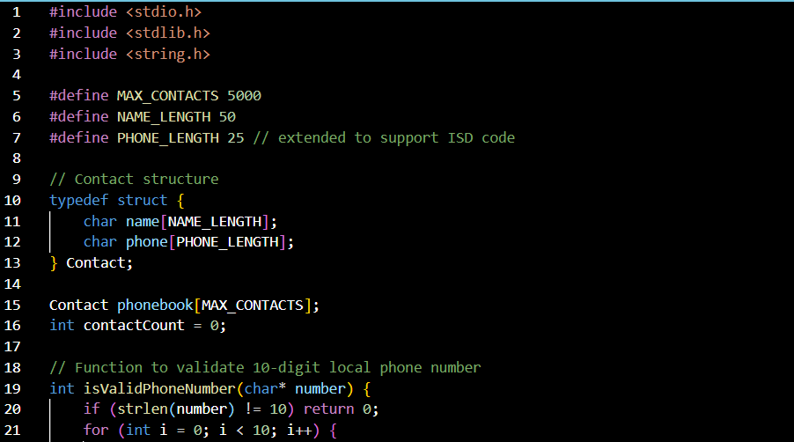

1

Slide 17
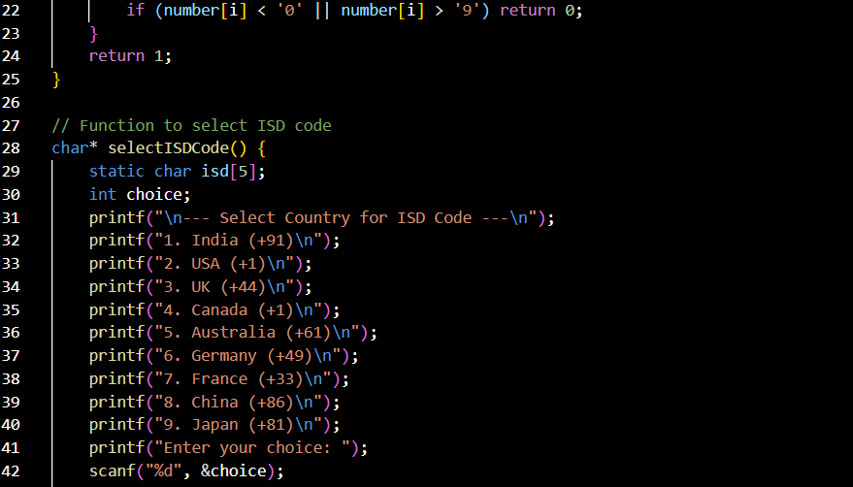
2

Slide 18
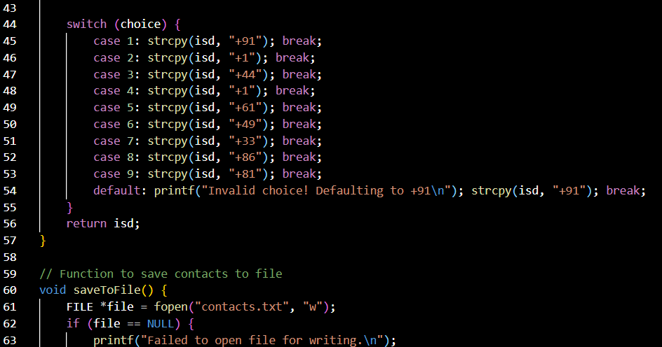
3

Slide 19
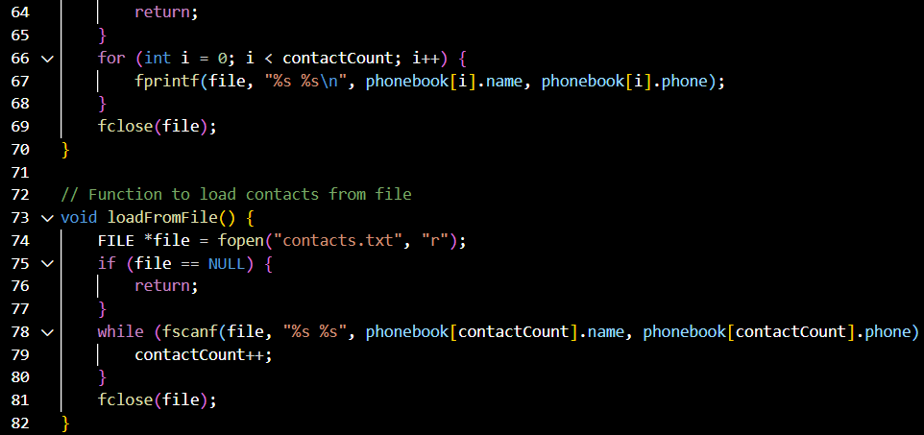
4

Slide 20
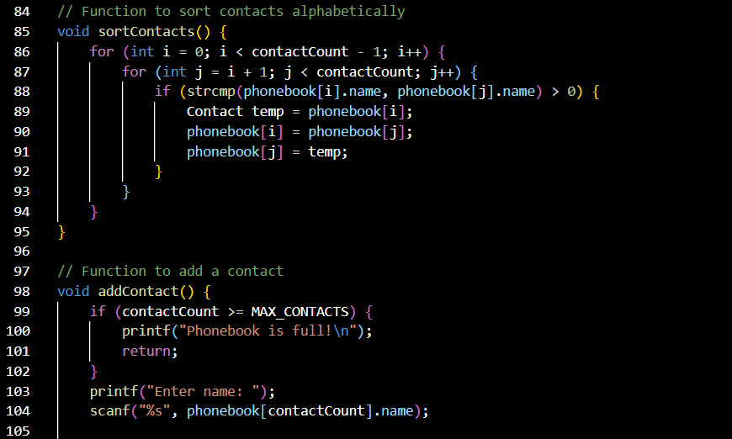
5

Slide 21
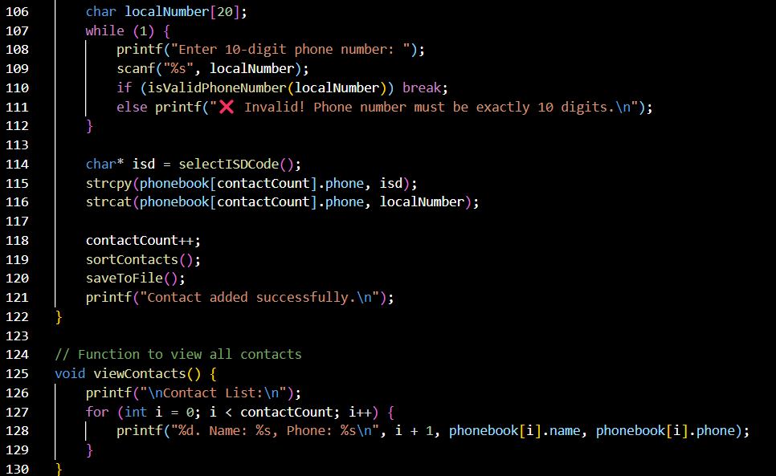
6

Slide 22
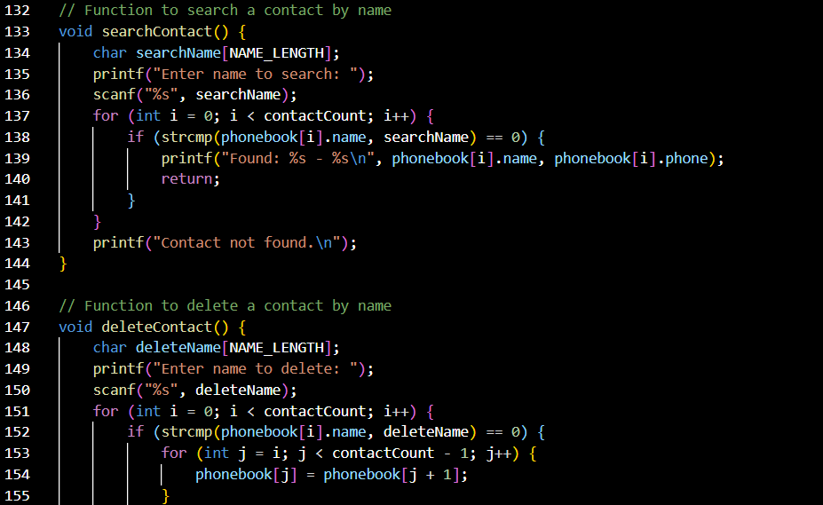
7

Slide 23
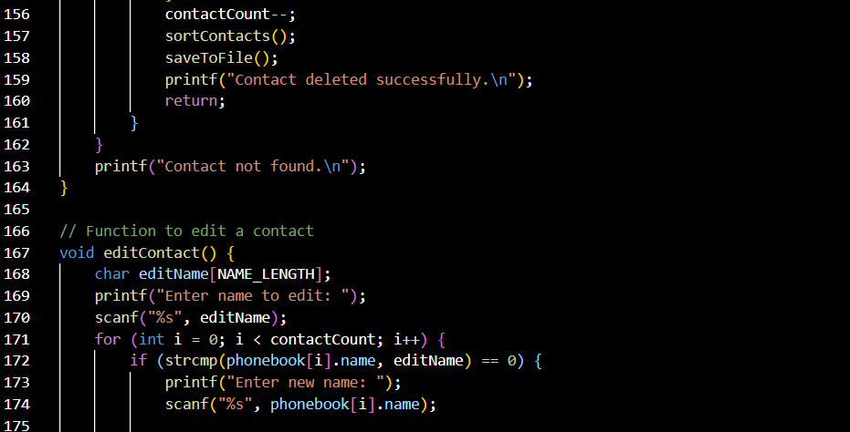
8

Slide 24
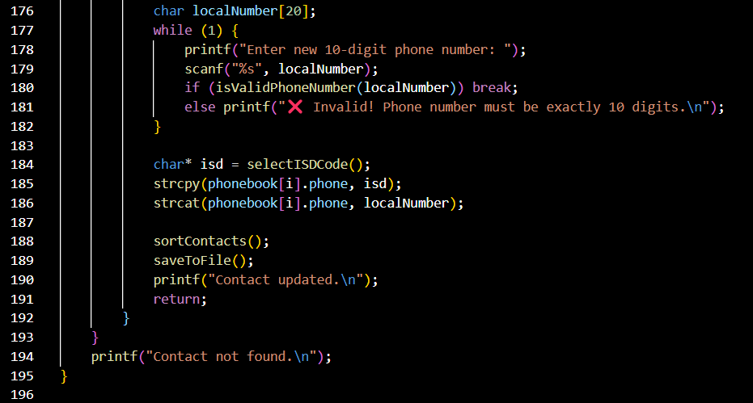
9

Slide 25
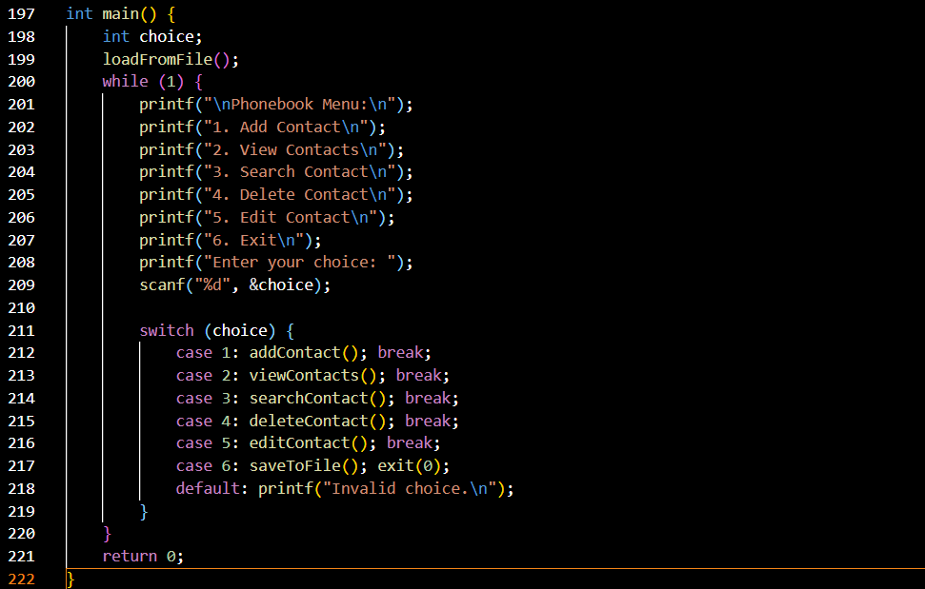
10

Slide 27
CONCLUSION

Slide 28
The Phonebook Application efficiently manages contacts using arrays or linked lists, allowing users to add, edit, delete, and search contacts. Sorting methods like Bubble Sort and searching algorithms like Linear Search enhance functionality, while file storage or databases ensure data persistence.
A structured user interface simplifies interaction, making the application user-friendly.
Future Improvements
CONCLUSION
Optimized Sorting & Searching: Implement more efficient algorithms like Merge Sort and Binary Search.
Database Integration: Upgrade to SQL-based storage for better scalability.
Enhanced UI: Develop a graphical interface for improved accessibility.
Cloud Sync: Enable cloud-based storage for cross-device access.

Slide 29
Nayab
Nasim
1232
Shadman
Ashraf
1254
Faiz
Ahmed
1266
Arhan
Abdullah
1236
Zaid
Akbar
1268

Slide 30
Shadman
Ashraf
1254
Faiz
Ahmed
1266
Nayab
Nasim
1232
Arhan
Abdullah
1236
Zaid
Akbar
1268

Slide 31
Faiz
Ahmed
1266
Shadman
Ashraf
1254
Nayab
Nasim
1232
Arhan
Abdullah
1236
Zaid
Akbar
1268

Slide 32
Faiz
Ahmed
1266
Nayab
Nasim
1232
Shadman
Ashraf
1254
Arhan
Abdullah
1236
Zaid
Akbar
1268

Slide 33
Faiz
Ahmed
1266
Nayab
Nasim
1232
Shadman
Ashraf
1254
Zaid
Akbar
1268
Arhan
Abdullah
1236

Slide 34
Nayab
Nasim
1232
Faiz
Ahmed
1266
Shadman
Ashraf
1254
Zaid
Akbar
1268
Arhan
Abdullah
1236

Slide 35
Nayab
Nasim
1232
Shadman
Ashraf
1254
Faiz
Ahmed
1266
Arhan
Abdullah
1236
Zaid
Akbar
1268

